Slide 1
PL/SQL Basics

Slide 2
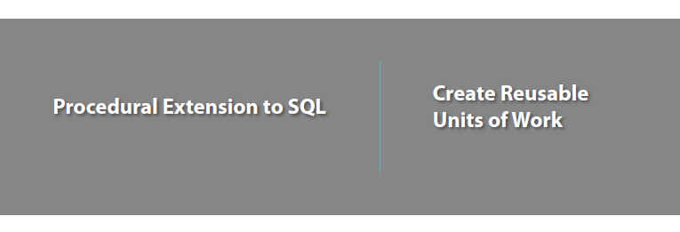
What is PL/SQL

Slide 3
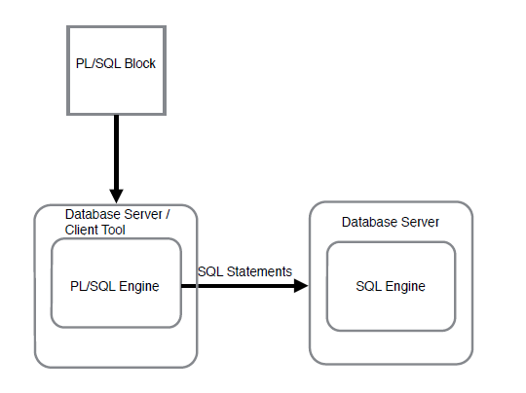
PL/SQL Processing

Slide 4
Anonymous Block
Basic Unit in Pl/Sql
Combine Sql statements as a block
For one off executions

Slide 5
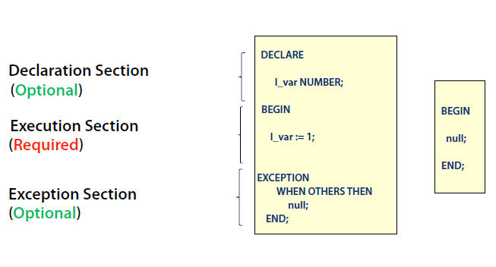
Structure of Anonymous Block

Slide 6
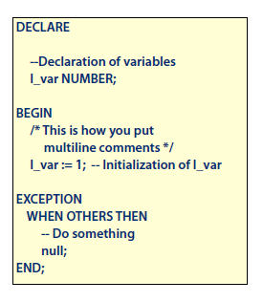
Comments
Single Line
Multi Line

Slide 7
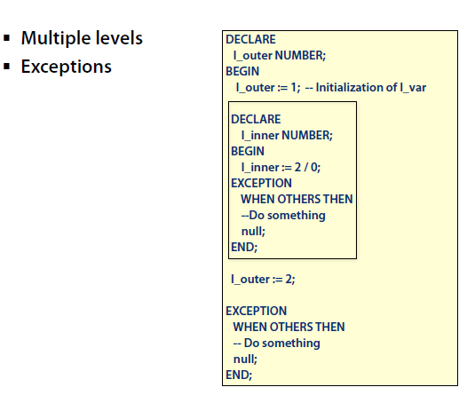
Nesting of Blocks

Slide 8
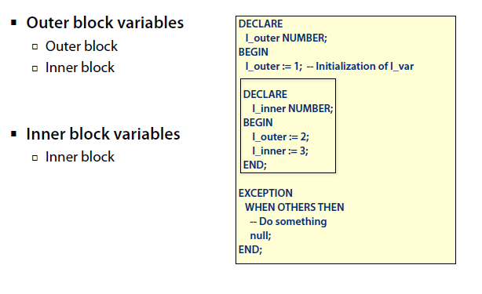
Scope of Variables

Slide 9
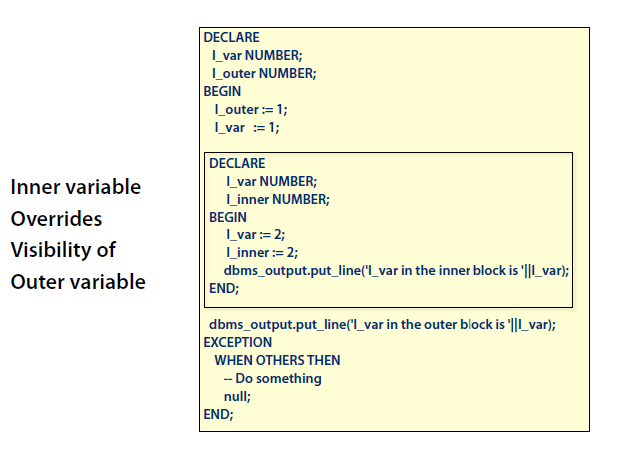
Visibility of Variables

Slide 10
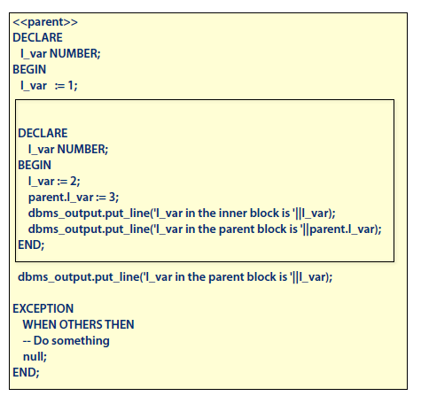
Block Labels

Slide 11
Data Types
Scalar Datatypes
Composite Datatypes
Reference Datatypes
Other Datatypes

Slide 12
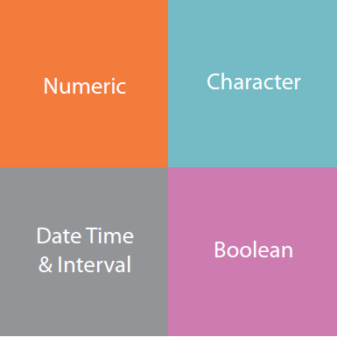
Scalar Data Types

Slide 13
Numeric Data Types
Number
Commonly Used
Range: 1E-130 to 1E126 Including 0
NUMBER (precision, scale)
Fixed Point Number
Precision
Total Number of Digits
Max Value : 38
Scale:
Where Rounding Occurs
Min : -84 Max: 127

Slide 14
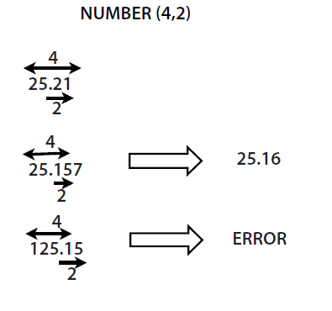
NUMBER (precision,scale)

Slide 15
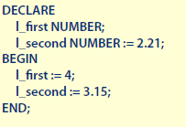
Assigning Values
Null Value if Not Assigned
Declaration Section
Execution Section
Initialized Every Time the Block is Executed

Slide 16
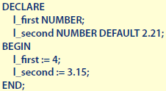
Default
Declaration Section

Slide 17
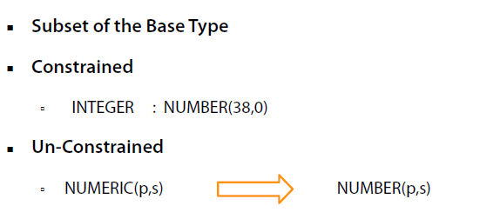
Subtypes

Slide 18
Character Data Types
Store Alphanumeric Data in Table Columns
Store Table and Column Names
Database Character Set
CHAR
VARCHAR2
CLOB

Slide 19
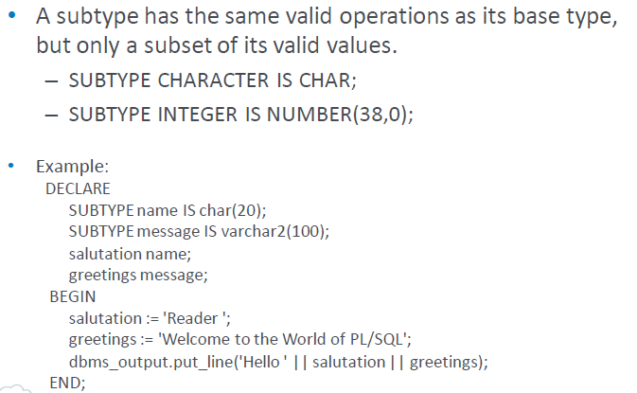
User Subtypes

Slide 20
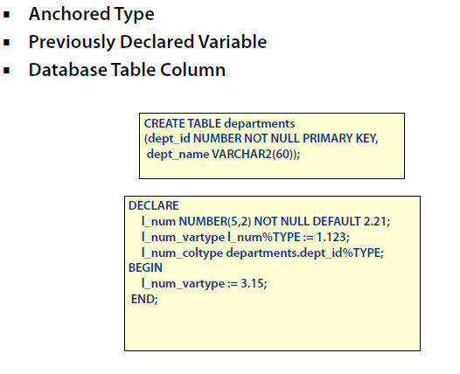
%Type

Slide 21
Composite Data Types
Records
Nested Tables
Varrays
Associative Arrays

Slide 22
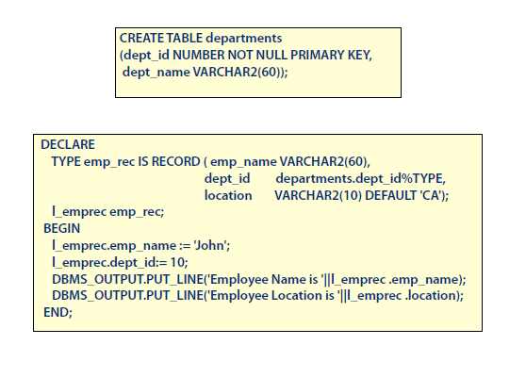
Record
Group of items
Dot Notation
TYPE rec_name IS RECORD ( Field Declaration[,Field Declaration]…)
TYPE rec_name IS RECORD ( Field Declaration[,Field Declaration]…)

Slide 23
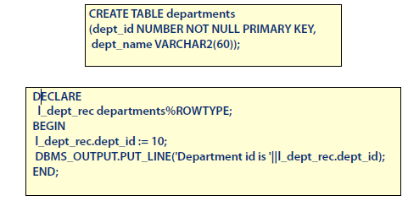
%ROWTYPE
Record Based On
Table
View
Cursor

Slide 24
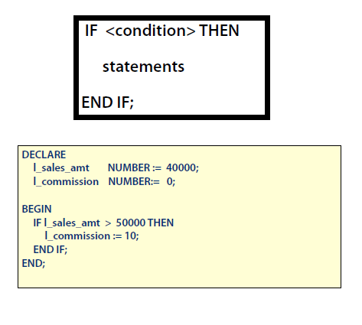
Conditional Statements

Slide 25
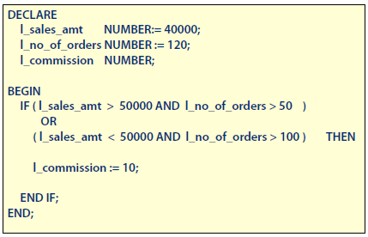
IF Statement

Slide 26
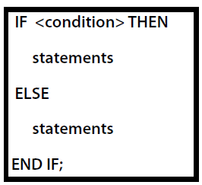
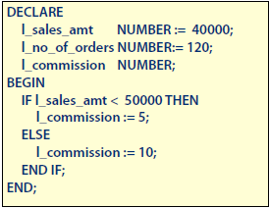
IF ELSE Statement

Slide 27
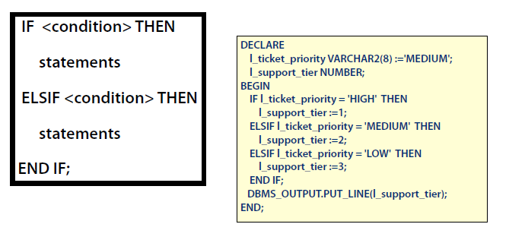
IF ELSIF

Slide 28
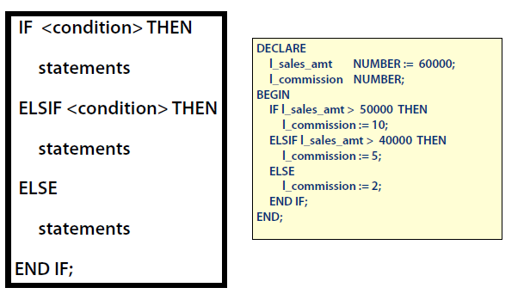
IF ELSIF ELSE Statement

Slide 29
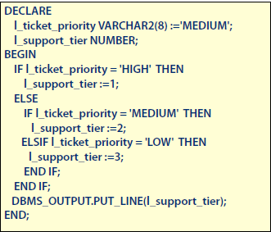
Nesting IF

Slide 30
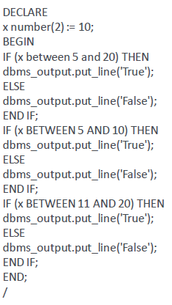
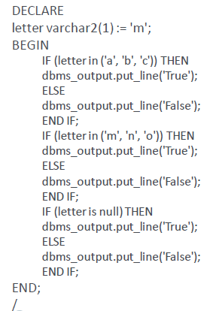
Using Between and IN with IF

Slide 31
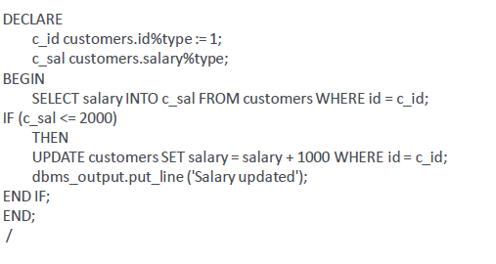
Using SQL Query with IF

Slide 32
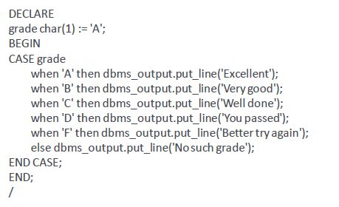
CASE

Slide 33
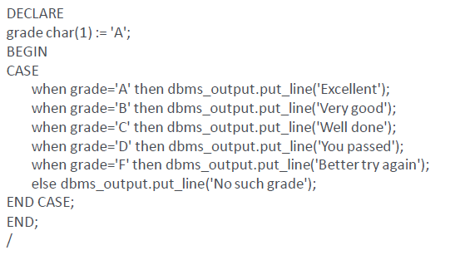
Searched CASE

Slide 34
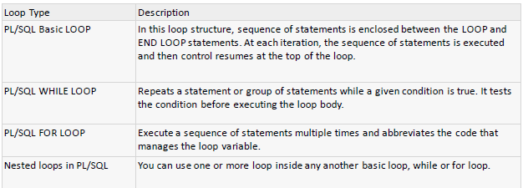
PL/SQL Loops

Slide 35
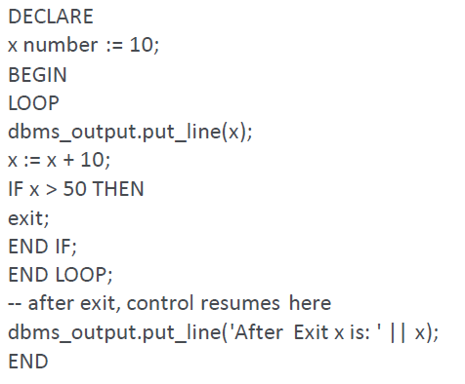
Basic Loop Example

Slide 36
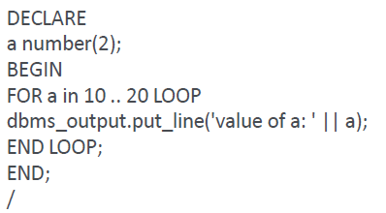
For Example

Slide 37
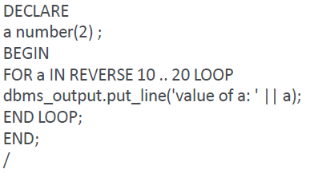
Reverse For Example

Slide 38
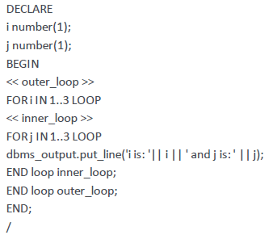
Labelling Loop - Example

Slide 39
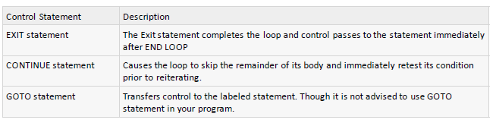
Loop Control Statements

Slide 40
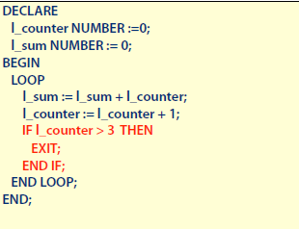
Exit Conditions

Slide 41
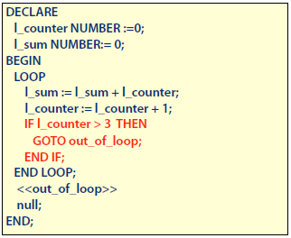
Exit Conditions

Slide 42
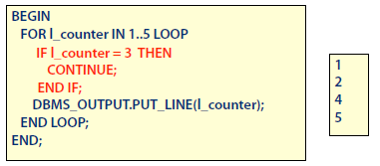
Continue

Slide 43
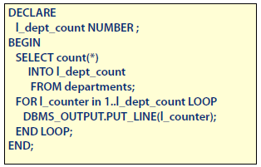
Dynamic Loop Counter

Slide 44
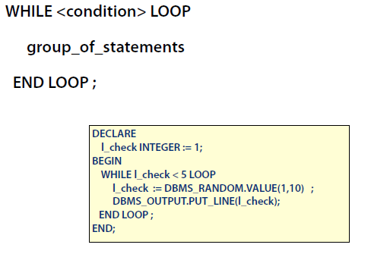
While Loop Example

Slide 45
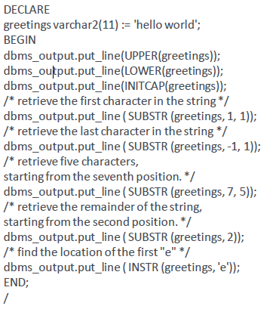
String Example

Slide 46
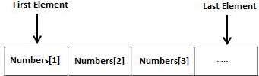
Arrays - VARRAY
The PL/SQL programming language provides a data structure called the VARRAY, which can store a fixed-size sequential collection of elements of the same type. A varray is used to store an ordered collection of data, however it is often better to think of an array as a collection of variables of the same type.
All varrays consist of contiguous memory locations. The lowest address corresponds to the first element and the highest address to the last element.
An array is a part of collection type data and it stands for variable-size arrays.
Each element in a varray has an index associated with it. It also has a maximum size that can be changed dynamically.

Slide 47
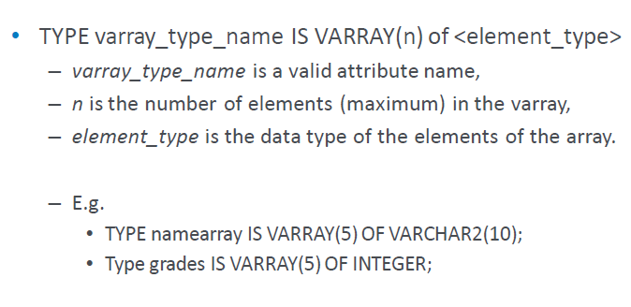
Declare varray

Slide 48
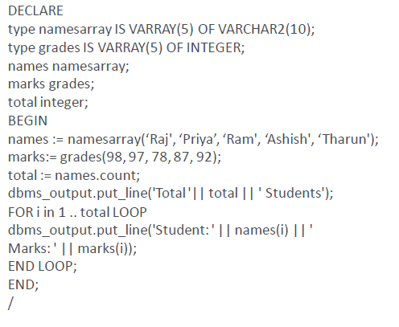
varray - Example

Slide 49
Implicit Cursors
When you execute DML statements like DELETE, INSERT, UPDATE and SELECT statements, implicit statements are created to process these statements.
Oracle provides few attributes called as implicit cursor attributes to check the status of DML operations. The cursor attributes available are %FOUND, %NOTFOUND, %ROWCOUNT, and %ISOPEN.

Slide 50
Implicit Cursors
For Example: Consider the PL/SQL Block that uses implicit cursor attributes as shown below:
DECLARE var_rows number(5);
BEGIN
UPDATE employee
SET salary = salary + 1000;
IF SQL%NOTFOUND THEN
dbms_output.put_line('None of the salaries where updated');
ELSIF SQL%FOUND THEN
var_rows := SQL%ROWCOUNT;
dbms_output.put_line('Salaries for ' || var_rows || 'employees are updated');
END IF;
END;

Slide 51
Explicit Cursor
An explicit cursor is defined in the declaration section of the PL/SQL Block. It is created on a SELECT Statement which returns more than one row. We can provide a suitable name for the cursor.
General Syntax for creating a cursor is as given below:
CURSOR cursor_name IS select_statement;
cursor_name – A suitable name for the cursor.
select_statement – A select query which returns multiple rows.
How to use Explicit Cursor?
There are four steps in using an Explicit Cursor.
DECLARE the cursor in the declaration section.
OPEN the cursor in the Execution Section.
FETCH the data from cursor into PL/SQL variables or records in the Execution Section.
CLOSE the cursor in the Execution Section before you end the PL/SQL Block.

Slide 52
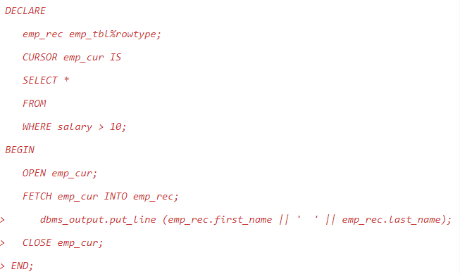
Explicit Cursor

Slide 53
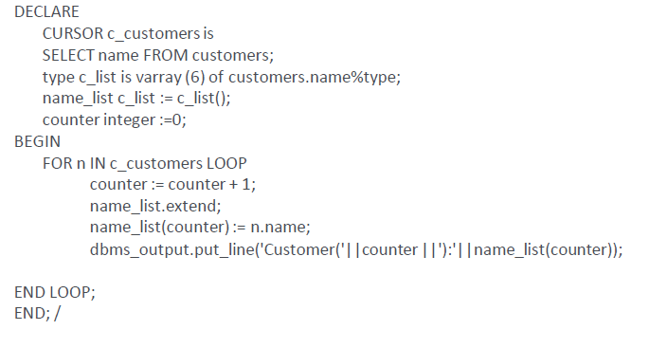
Explicit Cursor

Slide 54
Exceptions
Types of Exceptions
Internally Defined
Pre-Defined
User Defined

Slide 55
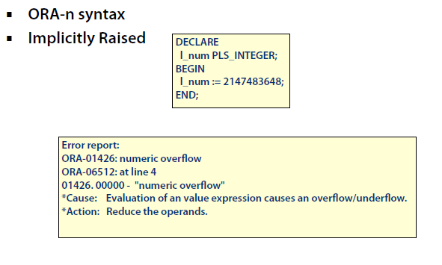
Internally Defined Exceptions

Slide 56
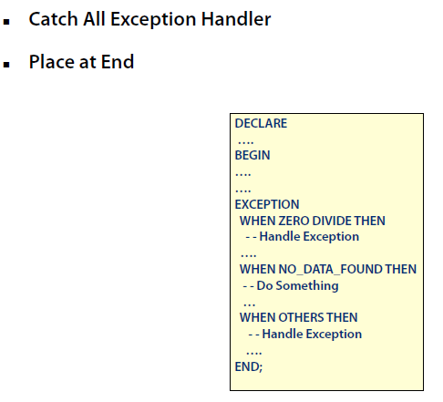
WHEN OTHERS Exception

Slide 57
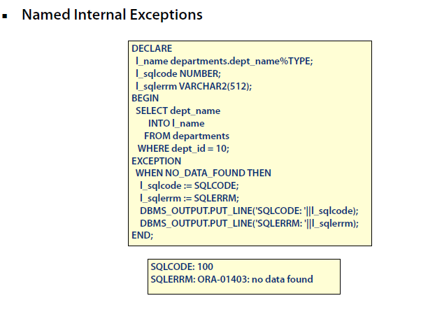
Pre-Defined Exceptions

Slide 58
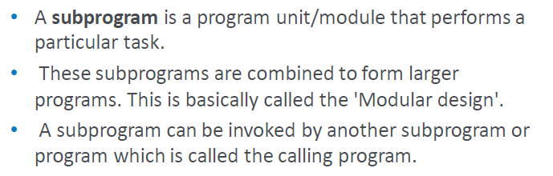
Sub Programs

Slide 59

Types of subprograms

Slide 60
Creating a Procedure
A procedure is created with the CREATE OR REPLACE PROCEDURE statement.
CREATE [OR REPLACE] PROCEDURE procedure_name[(parameter_name[IN | OUT | IN OUT] type [, ...])] {IS | AS}
BEGIN
< procedure_body>
END procedure_name;
procedure-namespecifies the name of the procedure.
[OR REPLACE] option allows modifying an existing procedure.
The optional parameter list contains name, mode and types of the parameters. IN represents that value will be passed from outside and OUT represents that this parameter will be used to return a value outside of the procedure.
procedure-bodycontains the executable part.
The AS keyword is used instead of the IS keyword for creating a standalone procedure.

Slide 61
Example - Procedure
CREATE OR REPLACE PROCEDURE greetings
AS
BEGIN
dbms_output.put_line('Hello World!');
END;
/

Slide 62
Executing Standalone Procedure
A standalone procedure can be called in two ways:
Using the EXECUTE keyword
EXECUTE greetings;
Calling the name of the procedure from a PL/SQL block
BEGIN
greetings;
END;

Slide 63

Deleting Standalone Procedure

Slide 64

Parameter Modes

Slide 65

Parameter Modes

Slide 66

Parameter Modes

Slide 67

Functions

Slide 68

Functions - Example

Slide 69

Calling the Function

Slide 70

Triggers

Slide 71

Benefits of Triggers

Slide 72

Creating Triggers

Slide 73

Trigger - Example

Slide 74

Trigger - Example
The price of a product changes constantly. It is important to maintain the history of the prices of the products.
We can create a trigger to update the 'product_price_history' table when the price of the product is updated in the 'product' table.

Slide 75

Trigger - Example
Creating the Trigger
Execute this trigger after saving as .sql file
Lets update the price of a product.
UPDATE PRODUCT SET unit_price = 800 WHERE product_id = 100
Once the above update query is executed, the trigger fires and updates the 'product_price_history' table.
If you ROLLBACK the transaction before committing to the database, the data inserted to the table is also rolled back.

